Slide 1
Wind power
Renewable energy source
Variable/intermittent production
Seasonal/daily/hourly variation in output
Moderately high investment cost
Low O&M costs
Energy output is site specific
Notes:
Typical characteristics of wind power

Slide 2
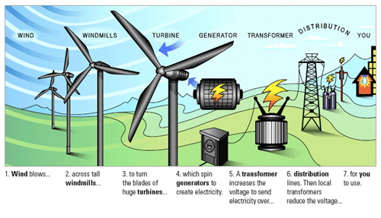
Wind power
Notes:
Image source: https://www.windpowerengineering.com/electrical/grid/xcel-energy-named-no-1-utility-wind-provider-for-11th-consecutive-yyear/

Slide 3
Onshore wind
Mature technology, lowest costs in the United States and China.
Overall performance of wind power depending on the specific characteristics of each location.
The capacity of a wind turbine can vary from a few kW to 9MW.
If the exact same (group of) wind turbine(s) is installed in different locations, the parameter that changes is the CapacityFactor.
Typical data can be found in the IRENA Renewable Power Generation Costs in 2017
Key characteristics
Onshore wind
Capital cost onshore | 1400 €/kW
FOM cost | 2.7% of capital
Avg. capacity factor | 23%
Indirect GHG emission factor | 10 tCO2 eq/GWh
Lifetime | 25 years

Slide 4
Offshore wind
Mature technology in Northern Europe, but experience still limited elsewhere.
In general, higher costs than onshore, but also higher performance (especially in terms of capacity factors).
Higher CapacityFactor due to lower disturbance of the flow, among others .
Key characteristics
Offshore wind
Capital cost onshore | 3470 €/kW
FOM cost | 3.7% of capital
Avg. capacity factor | 34%
Indirect GHG emission factor | 16 tCO2 eq/GWh
Lifetime | 25 years

Slide 5
Wind power – other aspects
Wind location is far from the grid and additional transmission line is needed:
  Add transmission costs to the plant, or
  Model connecting transmission line separately
Availability of wind plant during peak load:
  Can be modelled more precisely (but is also more complicated)
  Check results and verify that behavior is “normal” (i.e. wind power plant is not producing at full power during peak load)
  Limit operation of wind plant during peak time to avoid unrealistic results
Contribution to system reserve
  "Firm" power from wind is much lower compared to conventional techs (coal, oil, gas, nuclear, storage hydro…)

